Slide 1


SCIENTIFIC CHART READER
B. Tech Project | Sem 4
Arpit Gupta (B18EE006)
Raghav Ranjan (B18EE037)
Mentored By:
Dr. Anand Mishra

Slide 2

Problem Statement
To develop a fully automated system that returns the data extracted for bar charts
Motivation
Most scientific documents contain charts such as bar charts, pie charts, and other plots to visualize and present the results. These charts are information-rich.
However, most state-of-the-art OCR engines label them as graphics and do not read
and interpret them.

Slide 3

Basic Structure
Classification of Bar Graphs
(Deep Learning)
PROJECT
Extraction of Data
(Image Processing)
A Web Application to host this project
(Web Development)

Slide 4
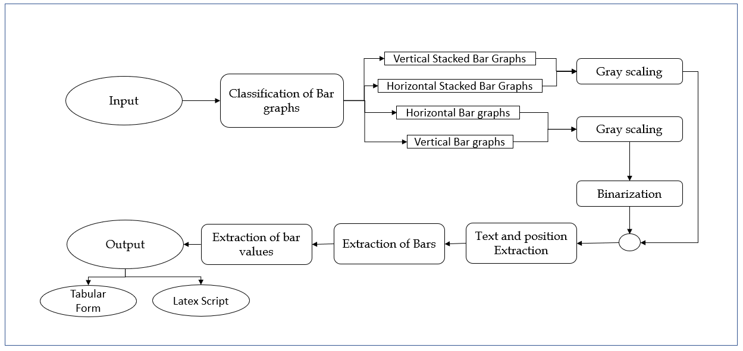
Flowchart

Slide 5
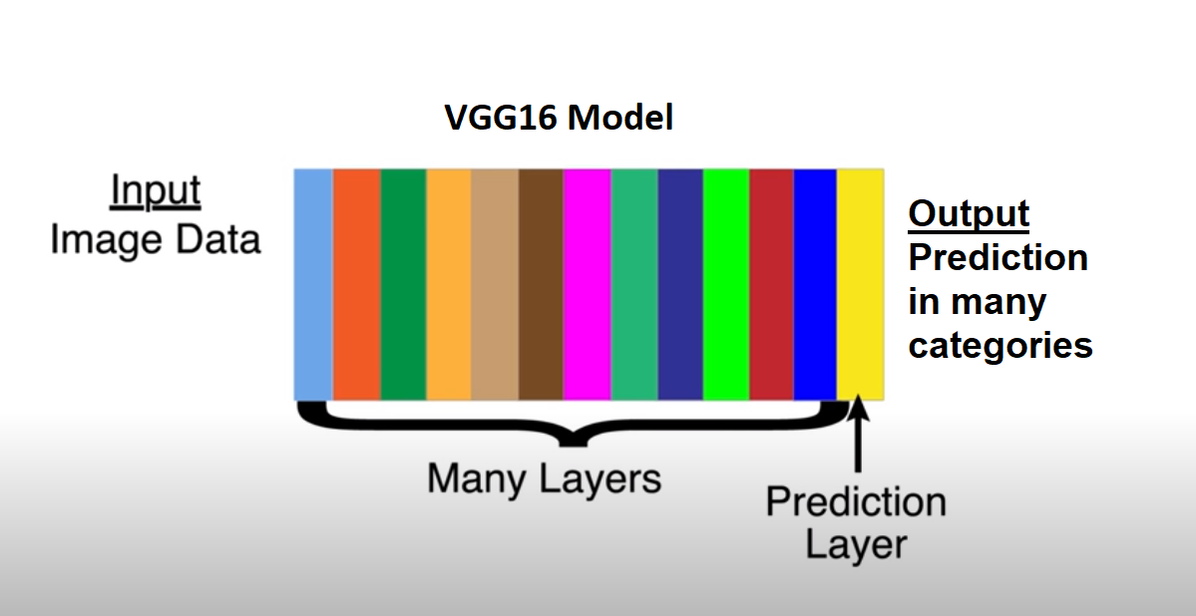
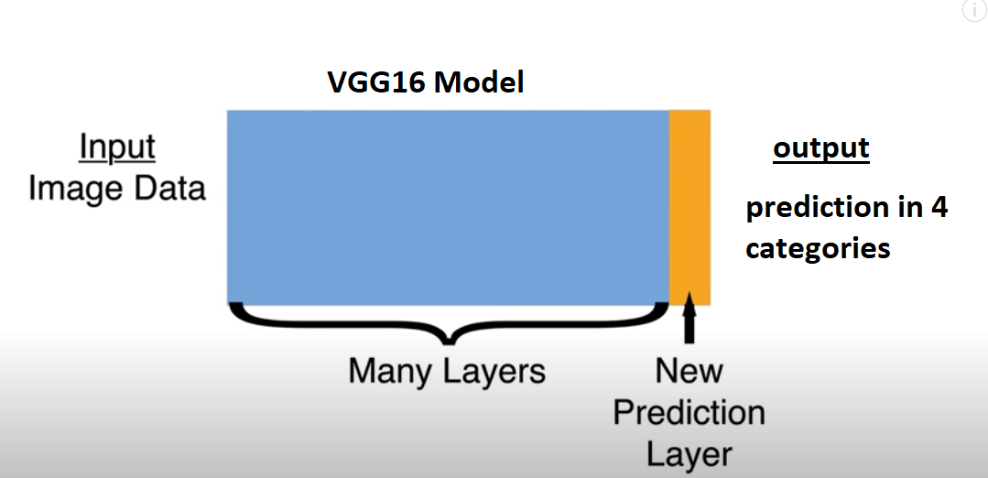
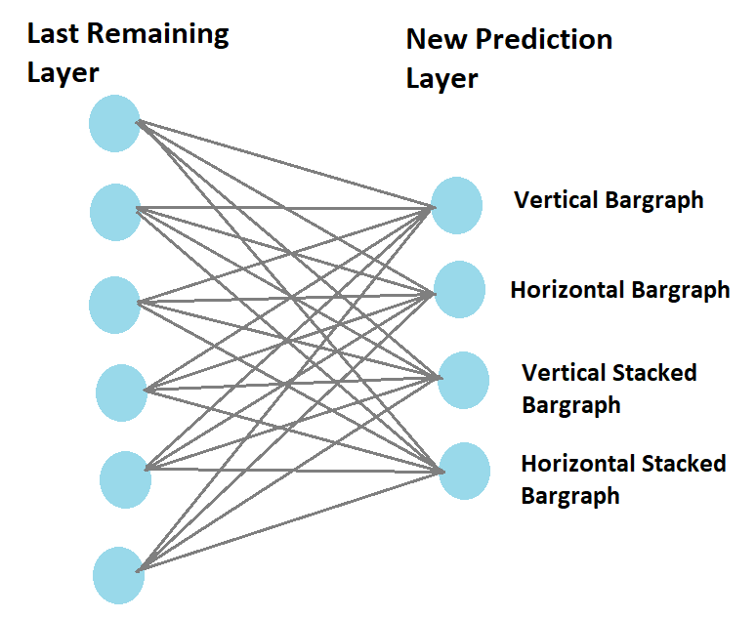
Classification of Bar Graphs
Total 16000 Bar graphs images : 4000 of each class
For testing we had 1000 unknown data on which we got 91.2% accuracy.
Fig 3: Node representation of last layers

Slide 6

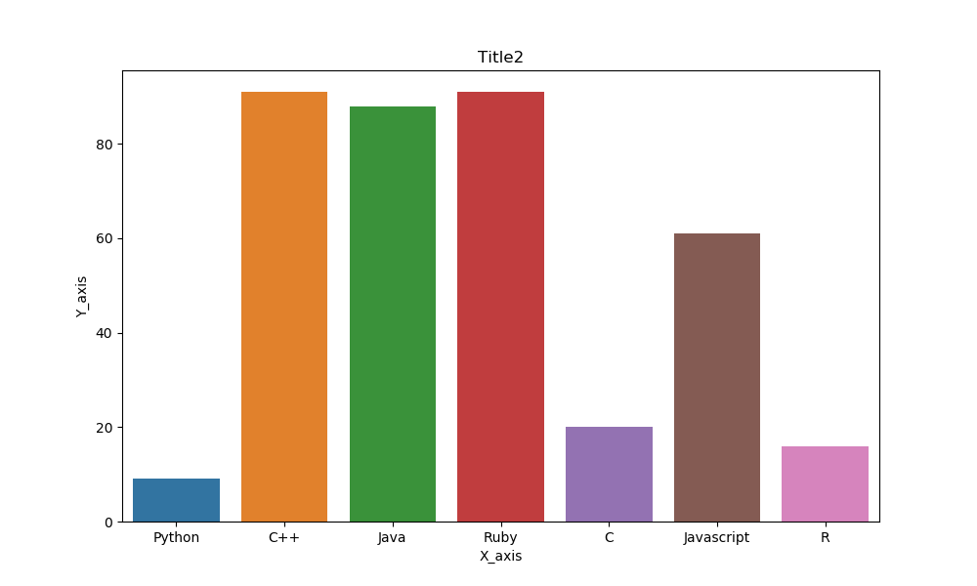
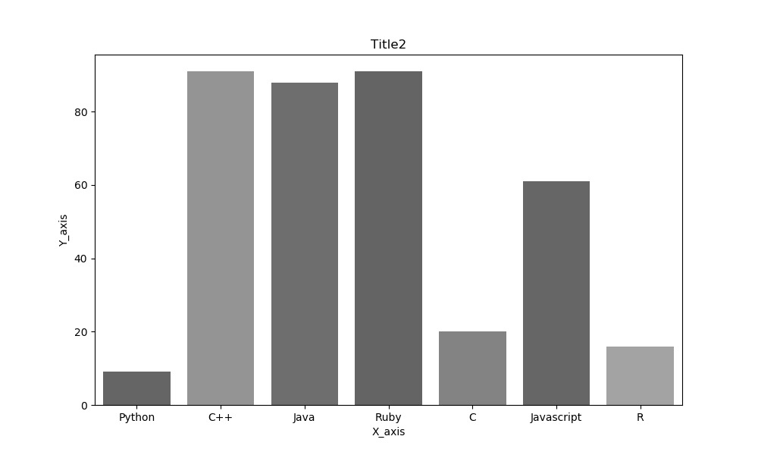
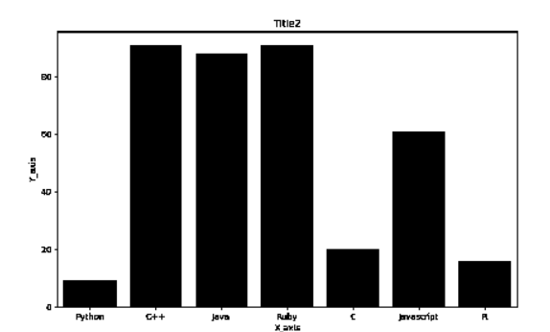
Preprocessing
2. Thresholding
3. Extraction of Bars
Gray scaling
Input Image
Extracted Bars
Grayscale Image
Binarized Image

Slide 7
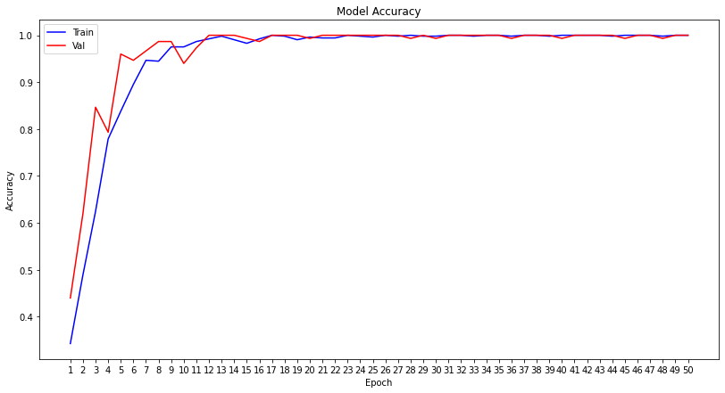
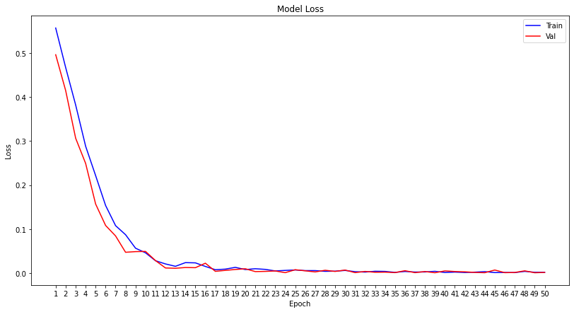
Fig 1 : Model Accuracy v/s Epoch
Fig 2 : Model Loss v/s Epoch

Slide 8
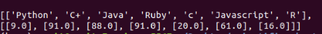

Extraction of Data
For Vertical Bar Graphs
a) Let’s see for Single Vertical Bar graph first
Extraction of Texts,Bar positions and ratio
Extraction of Bars
Extracted Bar heights
Extraction of Heights
Image thresholding
Input Image
Actual Values

Slide 9

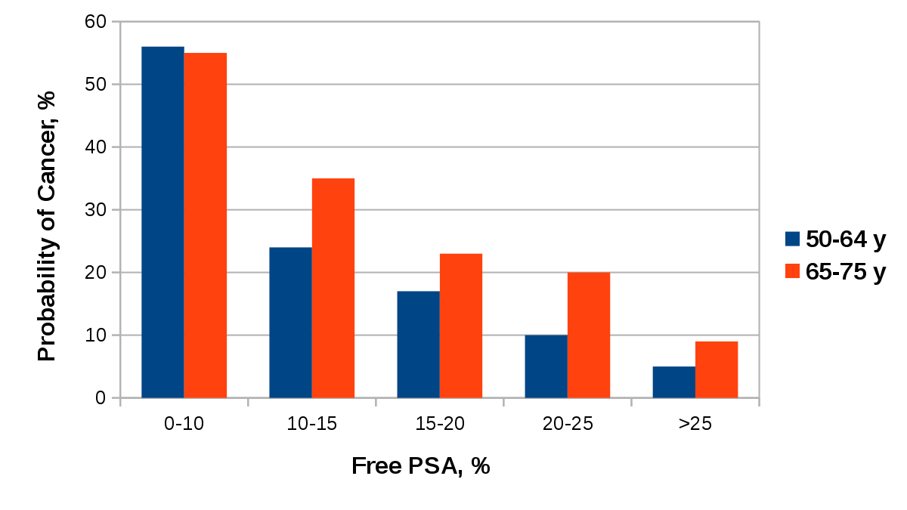
Extraction of Data
For Vertical Bar Graphs
b) Now let’s see for Multiple Vertical Bar graph
Extraction of bars
Extraction of heights
Input Image

Slide 10

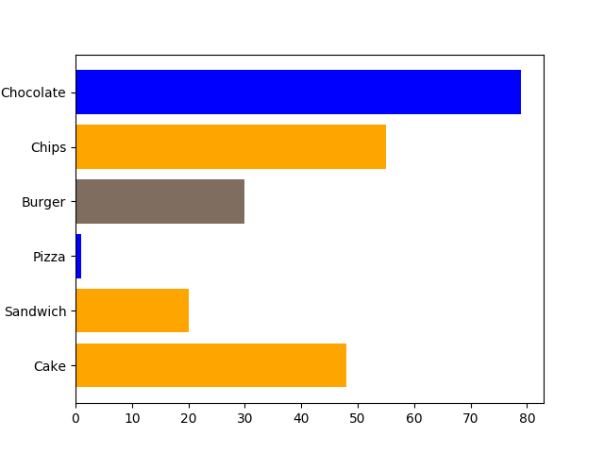
Extraction of Data
2. For Horizontal Bar Graphs
a) Let’s see for Single Horizontal Bar graph first
Extraction of bars
Extraction of heights
Input Image
Final Output

Slide 11

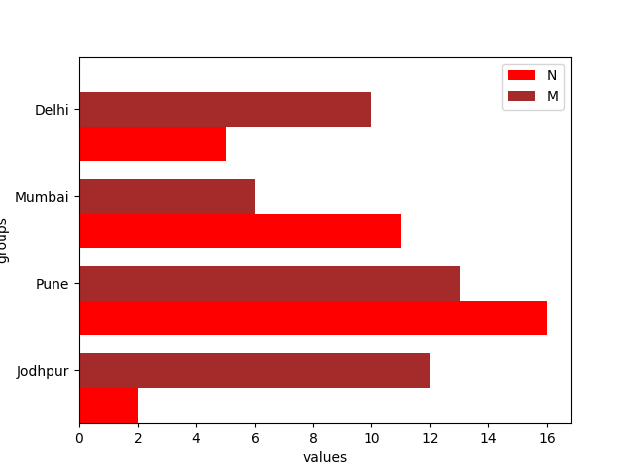
Extraction of Data
2. For Horizontal Bar Graphs
b) Now, Let’s see for Multiple Horizontal Bar graph
Extraction of heights
Extraction of bars
Input Image

Slide 12
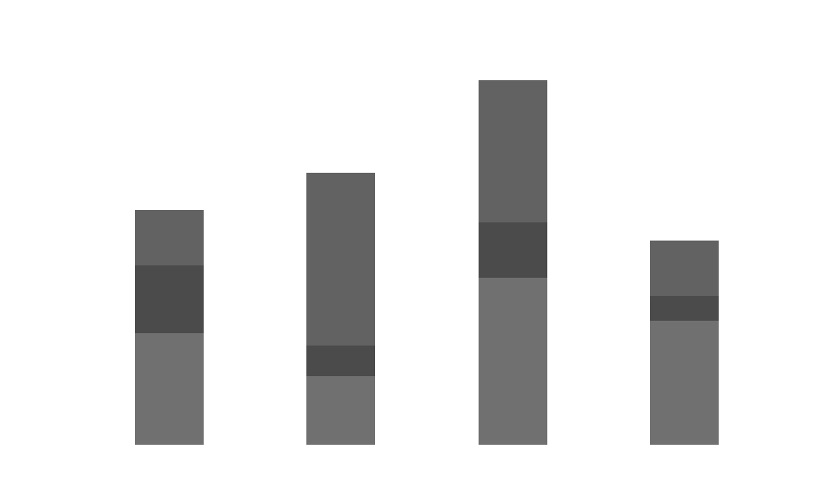
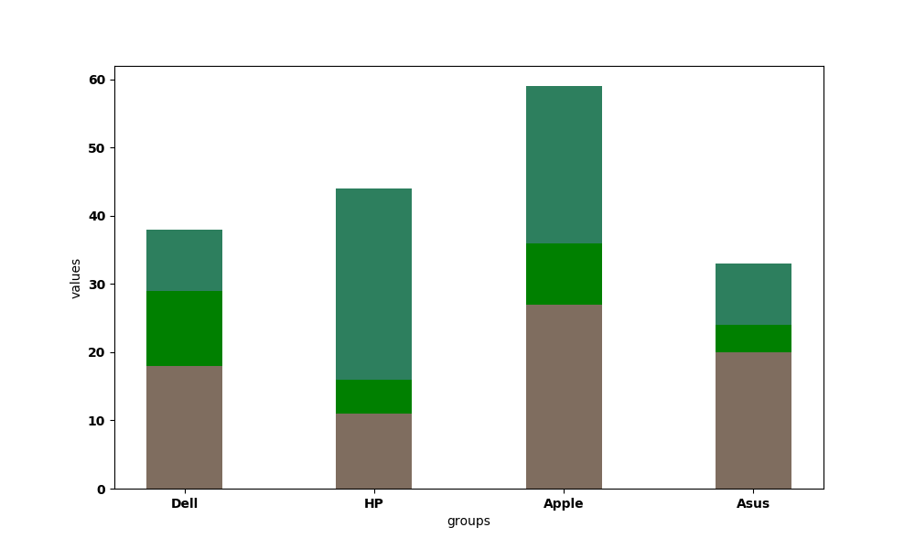
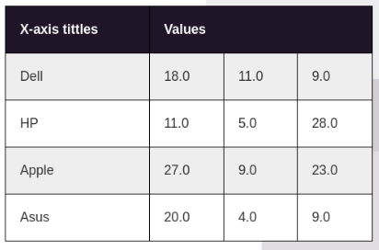
Extraction of Data
3. For Vertical Stacked Bar Graphs
Extraction of Heights
Extraction of Bars
Final Output
Input Image

Slide 13

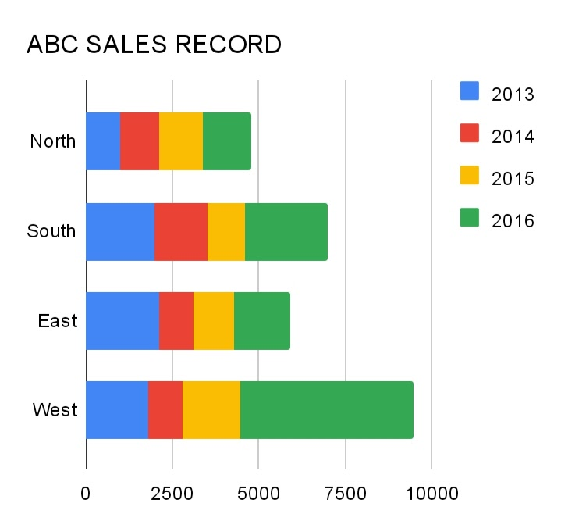
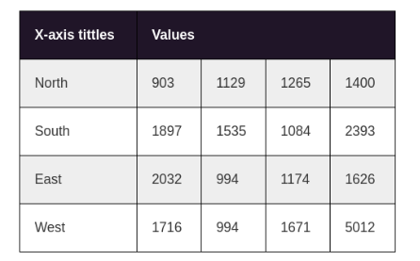
Extraction of Data
3. For Horizontal Stacked Bar Graphs
Extraction of Heights
Extraction of Bars
Input Image
Final Output

Slide 14
Web Application
Built a Django based Web Application to extract data in tabular as well as in Latex form from an image of a Bar graph

Slide 15


Slide 16
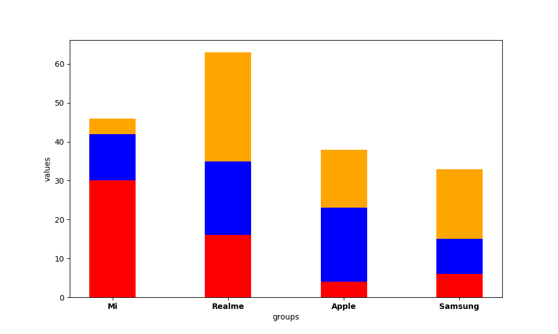
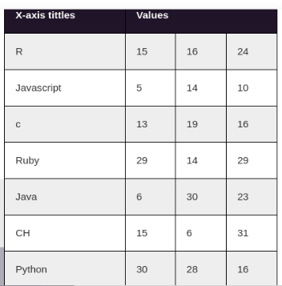
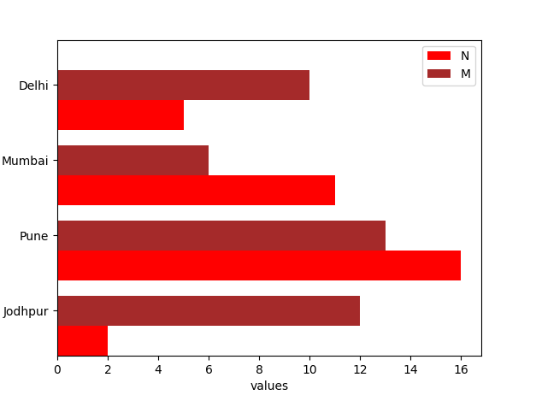
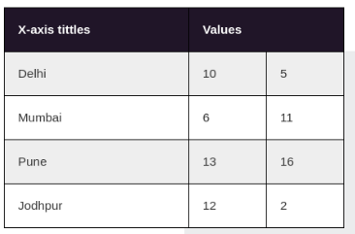
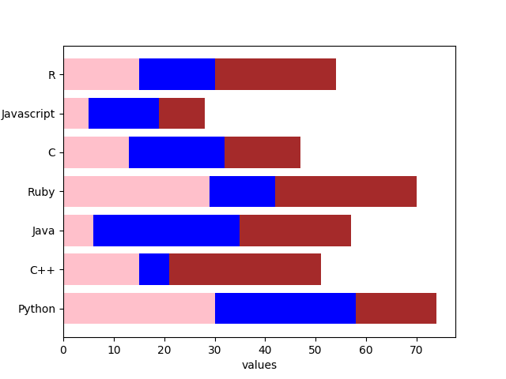
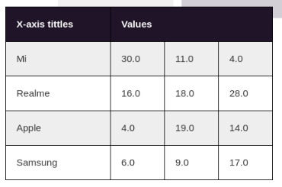
OBSERVATION
Input Image
Output
Actual Values
labels | values
Delhi | 10 | 5
Mumbai | 6 | 11
Pune | 13 | 15
Jodhpur | 12 | 2
labels | values
Mi | 30 | 11 | 4
realme | 16 | 18 | 28
apple | 4 | 19 | 14
samsung | 6 | 9 | 17
labels | values
R | 15 | 16 | 24
Javascript | 5 | 14 | 10
C | 13 | 19 | 16
Ruby | 29 | 14 | 29
Java | 6 | 30 | 23
C++ | 15 | 6 | 31
Python | 30 | 28 | 15

Slide 17

Results and Conclusion
The accuracy for Classifier comes out 91.2% for 1000 unknown data.
The calculated accuracy was calculated using mean absolute difference and It comes out to be different for different type of bar graphs
Simple Vertical Bar Graph : 99%
Simple Horizontal Bar Graph : 97%
Stacked Vertical : 94%
Stacked Horizontal : 91%
An average of 95.25% accuracy tested over 100 test images.

Slide 18
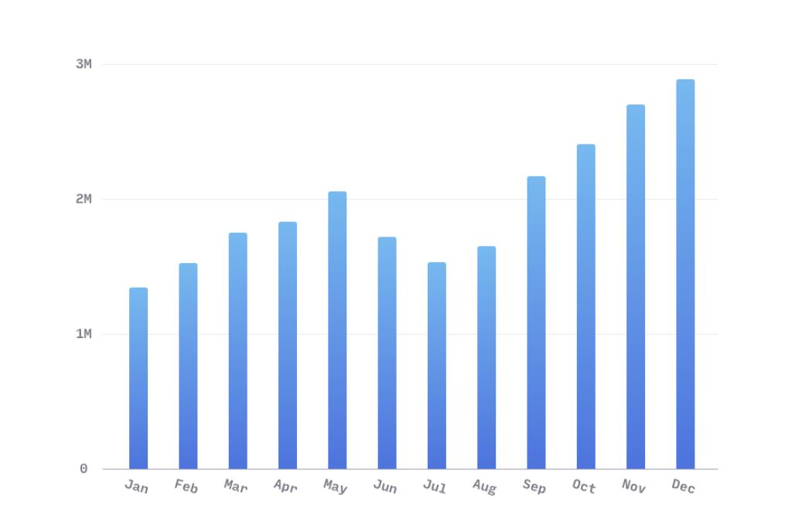
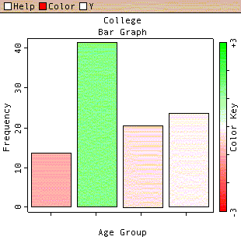
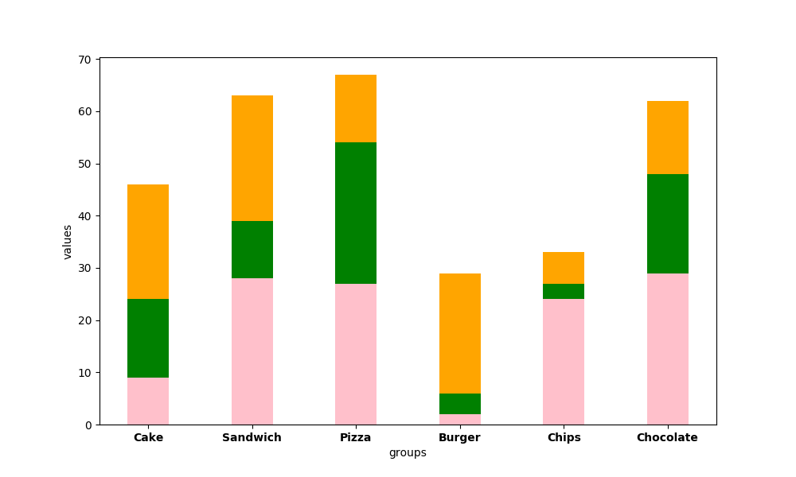
Limitations

Slide 19

Future Aspects
Further use RNN to improve OCR accuracy
To extract the data from other type of graphs like pie chart, line graphs etc.

Slide 20
References
[1] Abhijit Balaji1, Thuvaarakkesh Ramanathan, Venkateshwarlu Sonathi “ Chart-Text: A
Fully Automated Chart Image Descriptor”
[2] Object detection and classification public notebook on kaggle.com.2019
https://www.kaggle.com/navidrashik/object-detection-and-classification
[3] Kanan Vyas, “ A Box detection algorithm for any image containing boxes .” An article on
medium.com. July 2018.
https://medium.com/coinmonks/a-box-detection-algorithm-for-any-image-containing-
boxes-756c15d7ed26
[3] Nickson Joram, “ Morphological Operations in Image Processing .”An article on
medium.com. Jan 2020.
https://medium.com/@himnickson/

Slide 21
Thank You ☺

